Slide 1

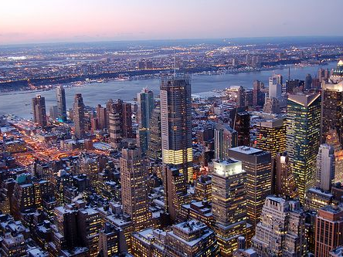

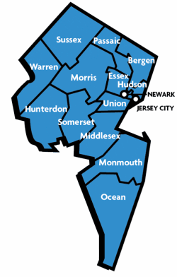
Regional-Level Dynamic Traffic Assignment Modeling with CUBE Avenue
DTA Research & Development
Date: December 5, 2013

Slide 2
Feasibility Assessment Objectives
Demonstrate the feasibility of developing a DTA process for a large, congested metropolitan area.
Evaluate the capability of an existing software package that handles this task.
Assess the effort required to prepare associated input data and additional model processing time from an existing regional model.
Evaluate the viability of model results.
Assess process to transition from regional level to corridor level to support more detailed analysis.

Slide 3
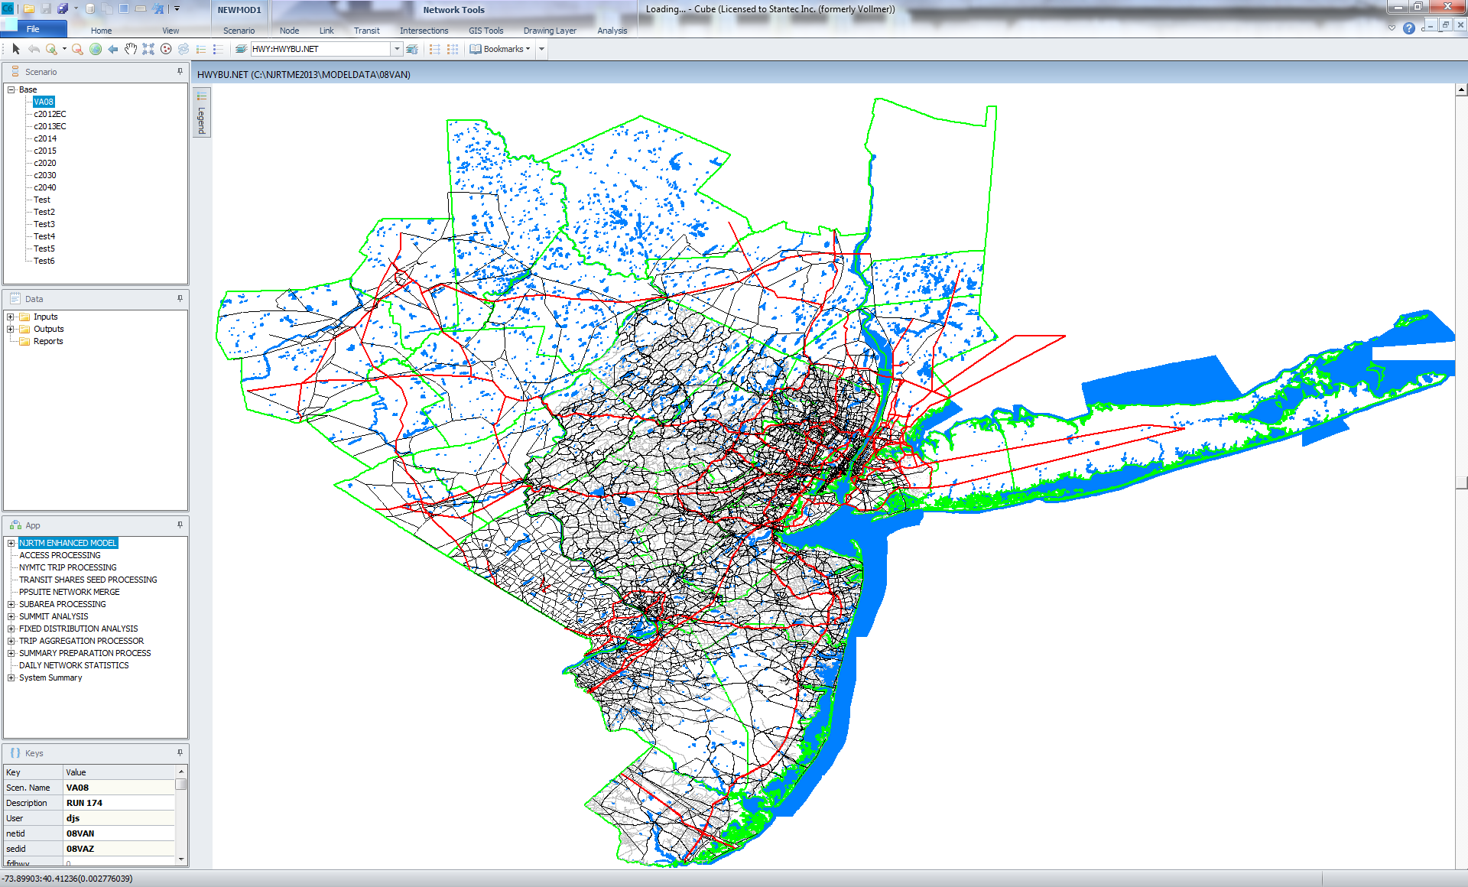
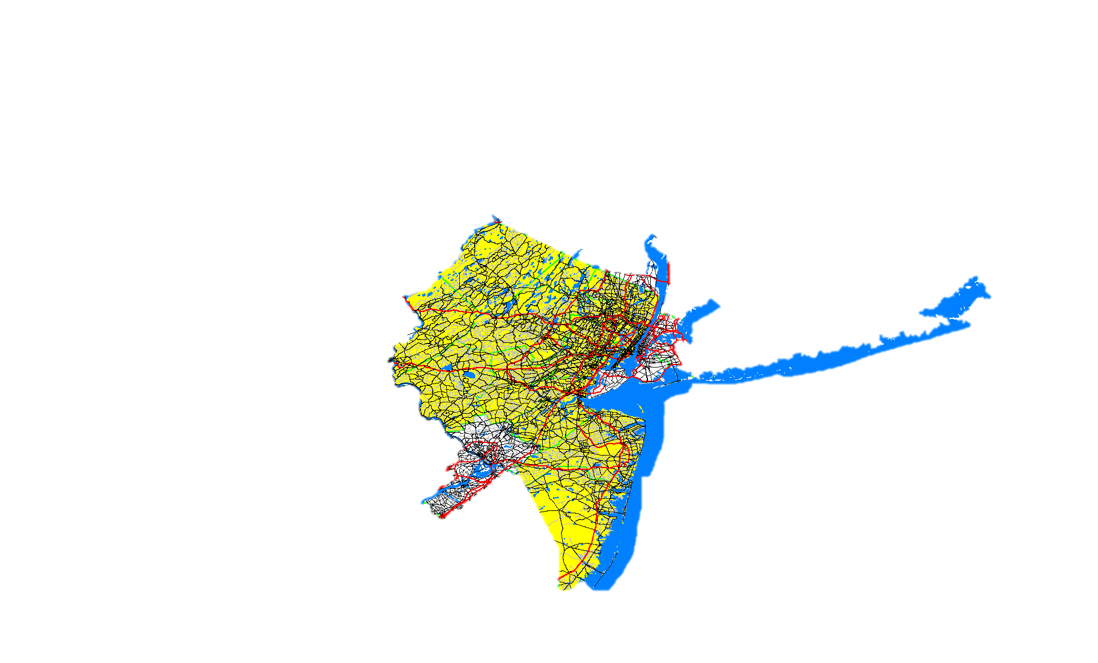
Process Overview
Exploring Options…
Using NJRTME Platform
- Multi-level Evaluation
1. 13 NJTPA Counties
2. I-80/US 46/NJ 23 corridor

Slide 4
Why Use the NJRTME?
Model for one of the largest MPOs in the nation.
Many residents of the MPO work in New York City.
The 13-NJTPA counties contain:
6.5 million residents
2.9 million jobs
17.1 million people in adjoining areas
25,000 miles of roads
250 bus routes, 12 rail lines

Slide 5
Methodology
NJRTME Regional Model
40 Counties, Cube Voyager Static Assignment using NJRTME’s Intersection Link Capacity Estimation
(Function of intersection lanes & traffic control devices)
DTA Regional Analysis
13 NJTPA Counties, Cube Avenue with NJRTME’s Intersection link capacity estimation
DTA Corridor Analysis
Using CUBE Avenue and Voyager’s more-detailed intersection modeling.

Slide 6
Topics of Discussion:
1 Regional DTA Objectives
2 Modeling Process
3 Preliminary Model Results
4 Corridor Level Analysis
5 Looking Ahead

Slide 7
Regional DTA Objectives
1
A cost-effective modeling platform to more realistically reflect operational constraints to support transportation modeling analysis at both the regional and corridor levels.

Slide 8
Regional DTA Objectives
Utilize a mesoscopic simulation platform that enables more realistic modeling of traffic congestion, where traffic is constrained by roadway capacity and queuing of vehicles is reflected.
Modeling Platform | Model Characteristics
Macroscopic | Static traffic assignment, not operationally constrained
Mesoscopic | Dynamic traffic assignment, operationally constrained; individual vehicle behavior not considered
Microscopic | Dynamic traffic assignment, operationally constrained; explicitly models individual vehicle behavior

Slide 9
Objective of Regional DTA
Applicable for transportation planning in metropolitan areas with severe traffic congestion:
  Regional - Planning Analysis
  Corridor - Planning Analysis & Design Support
Easily adopted from existing modeling platform.
Cost effective in terms of model input data requirements (i.e. network and trip matrices).

Slide 10
DTA Modeling Process
2
How do we do it?

Slide 11
Model Framework
Software platform: CUBE Avenue.
Study area includes the13-County NJTPA region, a total of 1,635 zones (Internal TAZs+ External Stations).
Approximately 34,500 network links and 14,000 nodes.
Leveraging existing model inputs including the highway network and matrices provided from NJRTME.

Slide 12
Modeling Process
Use 3-Hour AM peak period demand by vehicle class (SOV, HOV and Trucks) as defined in NJRTME.
NJRTME network with link capacities that reflect Traffic Control Devices (TCDs) and intersection lane configurations and assumed conditions, modified as necessary for this demonstration.
Allocate trips into hourly demand with Stantec-developed temporal distribution sub-model, then further disaggregate into 15-minute intervals using observed travel patterns.
Modify CUBE Voyager standard highway traffic assignment scripts to enable CUBE Avenue DTA modeling.

Slide 13
Standard Regional Model Intersection Representation
1002
Major Arterial Approach:
2 lanes
Capacity of 1800 Veh./Hr.
Major Arterial
Minor Arterial
1000
1005
1003
Minor Arterial Approach:
1 lane
Capacity of 500 Veh./Hr.
1004

Slide 14
NJRTME Intersection Representation
1002
Major Arterial Approach:
2 lanes
1 Left Turn Lane
Green/Cycle Ratio = .55
Capacity of 2250 Veh./Hr.
Major Arterial
Minor Arterial
1000
1005
1003
Minor Arterial Approach:
1 lane
1 Left Turn Lane
Green/Cycle Ratio = .35
Capacity of 750 Veh./Hr.
1004

Slide 15
NJRTME Intersection Representation with Voyager Intersection Modeling
1002
Major Arterial Approach:
2 lanes
1 Left Turn Lane
Detailed Signal Phasing with Separate Turn Phase
Capacity by Movement
Capacity of 2350 Veh./Hr.
Major Arterial
Minor Arterial
1000
1005
1003
Minor Arterial Approach:
1 lane
1 Left Turn Lane
Detailed Signal Phasing with Separate Turn Phase
Capacity by Movement
Capacity of 650 Veh./Hr.
1004

Slide 16
Temporal Distribution Model
Required to partition 3-hour peak period demand into more disaggregate time periods.
Based on the premise that travelers adjust departure in response to highway congestion and travel distance.
2010 NYMTC-NJTPA Household Survey data was used to derive regression models to estimate departure hour as a function of travel distance and congested travel conditions.

Slide 17
Travel Demand Allocation
3-Hour AM Peak Period Demand
Temporal Distribution Model
Hourly Demand (6:00 to 7:00 AM)
Hourly Demand (7:00 to 8:00 AM)
Hourly Demand (8:00 to 9:00 AM)
Allocation using survey-based travel pattern
15-min Interval Demand
6:00 to 6:15 AM
6:15 to 6:30 AM
6:30 to 6:45 AM
6:45 to 7:00 AM
15-min Interval Demand
7:00 to 7:15 AM
7:15 to 7:30 AM
7:30 to 7:45 AM
7:45 to 8:00 AM
15-min Interval Demand
8:00 to 8:15 AM
8:15 to 8:30 AM
8:30 to 8:45 AM
8:45 to 9:00 AM

Slide 18
Temporal Distribution Model
Allocation factors by O-D pair, represented by simple regression model:
FacHr₁ = a₁ * Time_{c}/ Time_{ff} + b₁ *Distance + C₁
FacHr₂ = a₂ * Time_{c}/ Time_{ff} + b₂ *Distance + C₂
FacHr₃ = 1 – (FacHr₁ + FacHr₂)
Using observed distribution from household survey at regional level to further disaggregate into 15-minute intervals.

Slide 19
Regional DTA
Network & Assignment Limitations
Limited precision in network abstraction (e.g. intersection channelization & access points).
Link-based modeling using NJRTME intersection capacity estimation - without using detailed Voyager intersection modeling option.
Detailed travel characteristics such as weaving & merging/diverging of vehicles are not explicitly modeled in the assignment process.

Slide 20
Model Convergence vs. Processing Time
Cube 6 – 32 Bit Version
Requires approximately 15 hours for 15-iteration model run (Intel Xeon CPU @ 2.4GHz with 64 Gb RAM)

Slide 21
Preliminary Model Results
3
How does it reflect reality?

Slide 22
Observed Traffic Data
Leverage readily available statistics / data for limited validation effort.
Traffic counts were obtained from the latest model validation data (2011)
Target travel speeds by facility type from the NJRTME validation.
Sample observed travel speed by TRANSCOM (Graphical)

Slide 23
VMT Comparison
Vehicle Miles of Travel (VMT) comparison with static traffic assignment.

Slide 24
Observed vs. Estimated Congested Speed by Facility Type

Slide 25
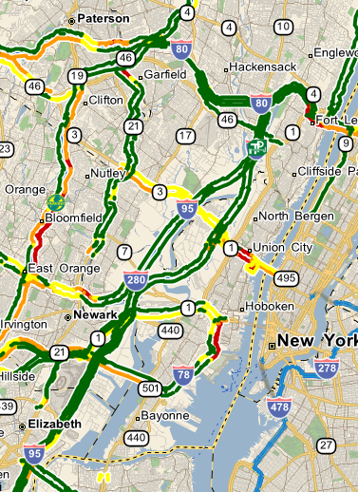
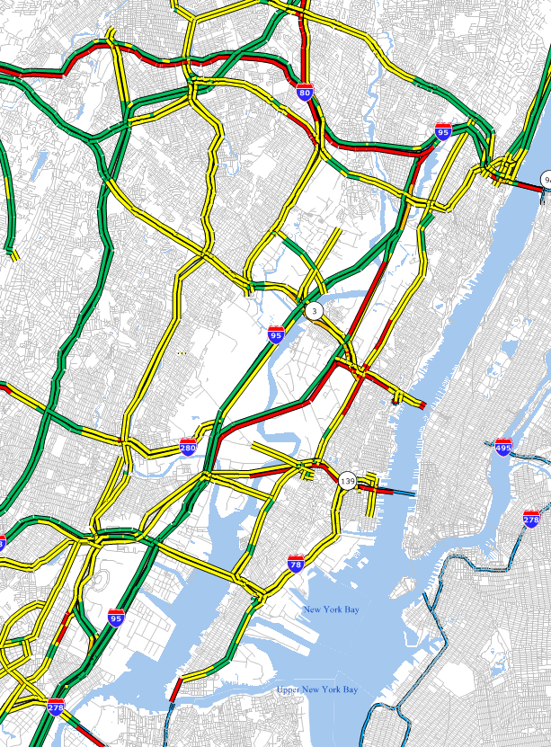
Preliminary Model Results
Source: Transcom website

Slide 26
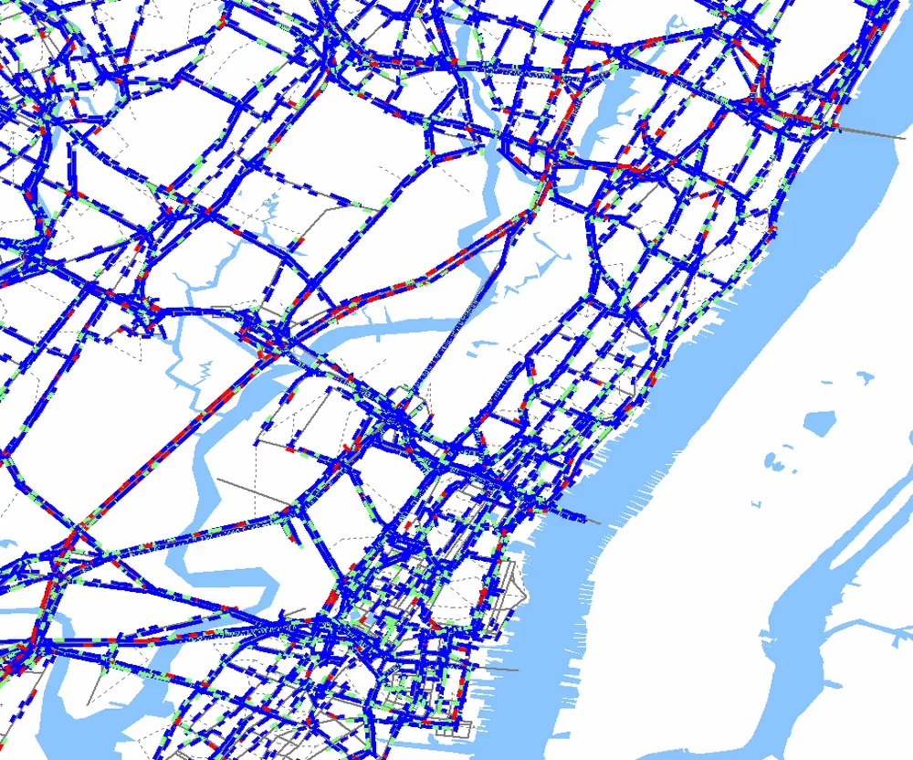
Sample Animation
Hudson River Approaches

Slide 27
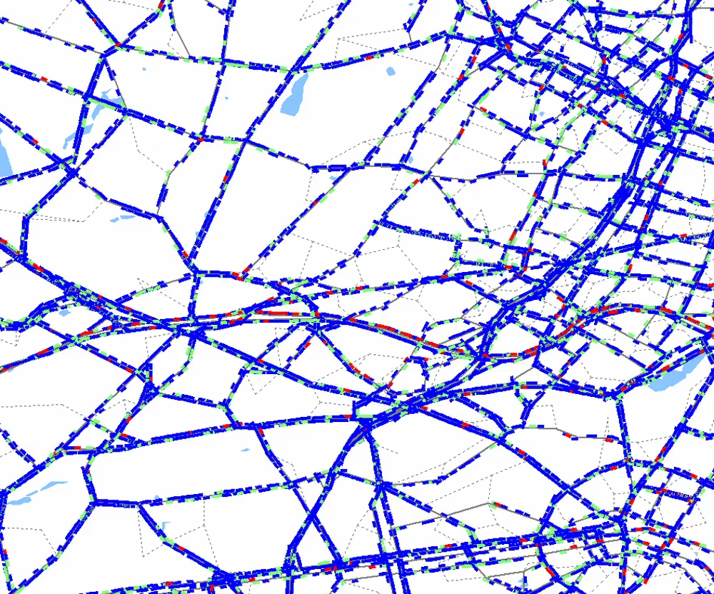
Sample Animation
I-78 Approaching Newark

Slide 28
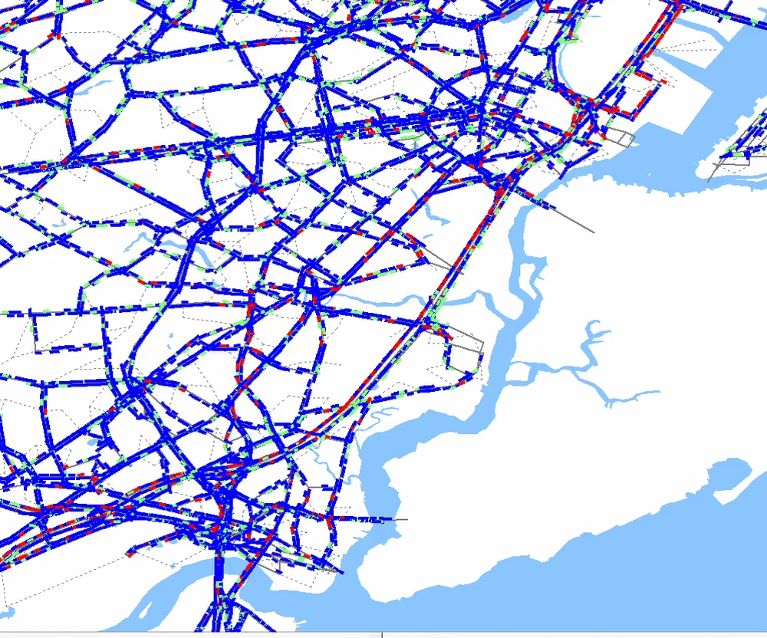
Sample Animation
NJ Turnpike near Elizabeth

Slide 29
Summary of Results
Compares well against travel speed by facility type and at network-wide level.
Appears to provide realistic representation of congestion levels along major corridors by visual inspection.

Slide 30
Corridor Level Analysis
4
Providing enhanced level of analysis in more focused area

Slide 31
Methodology and Model Input Requirements
Utilize Voyager intersection modeling procedure to more realistically reflect turn movement capacity.
Requires additional network details for study area
( I-80/US 46/NJ 23 corridor):
  Verify physical roadway characteristics—network connectivity, number of lanes at mid-block.
  Intersection characteristics—configuration, traffic control device types and associated details (e.g. yield/stop signs, traffic signal phasing/timing).

Slide 32
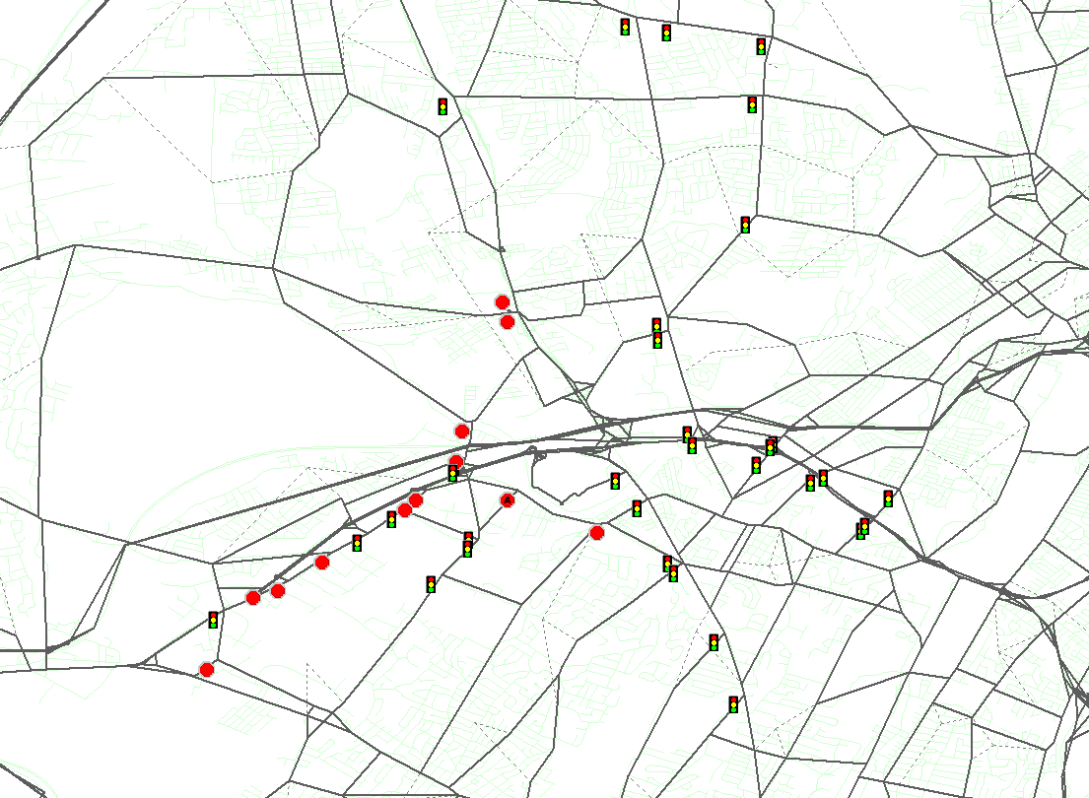
Congested North Jersey Corridor (I-80/US46/NJ23)
NJ 23
US 202
US 202
I-80
I-80
US 46
US 46
NJ 23

Slide 33
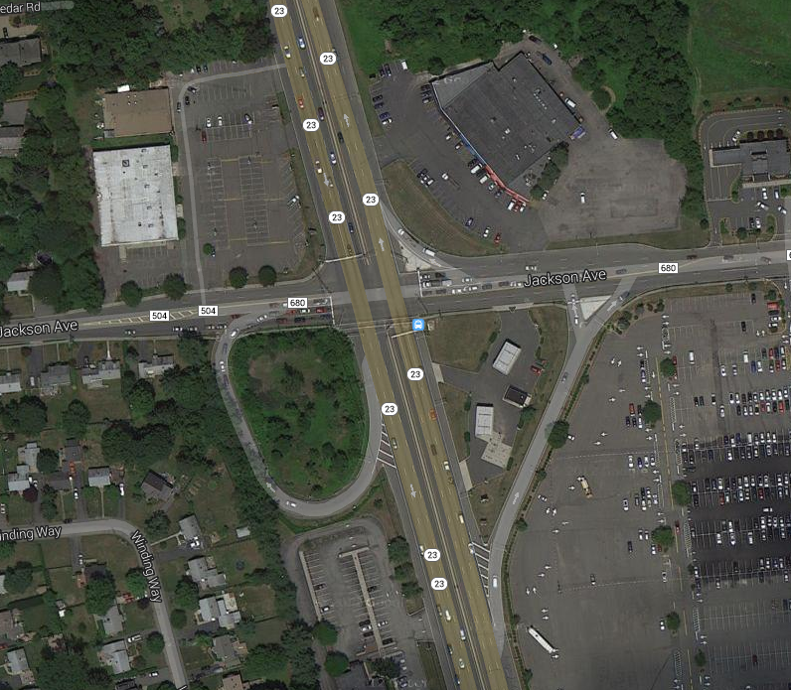
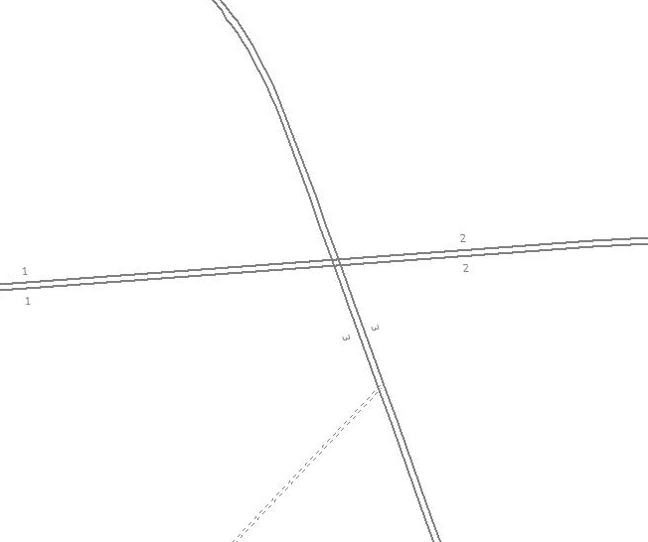
Verification of Network Coding

Slide 34
Model Outputs & Process Evaluation
Additional model outputs by intersection, including volumes, delay and Level-of-Service (LOS) on turn-by-turn basis.
Minimal changes to basic model platform.
No noticeable increases in model processing time.

Slide 35
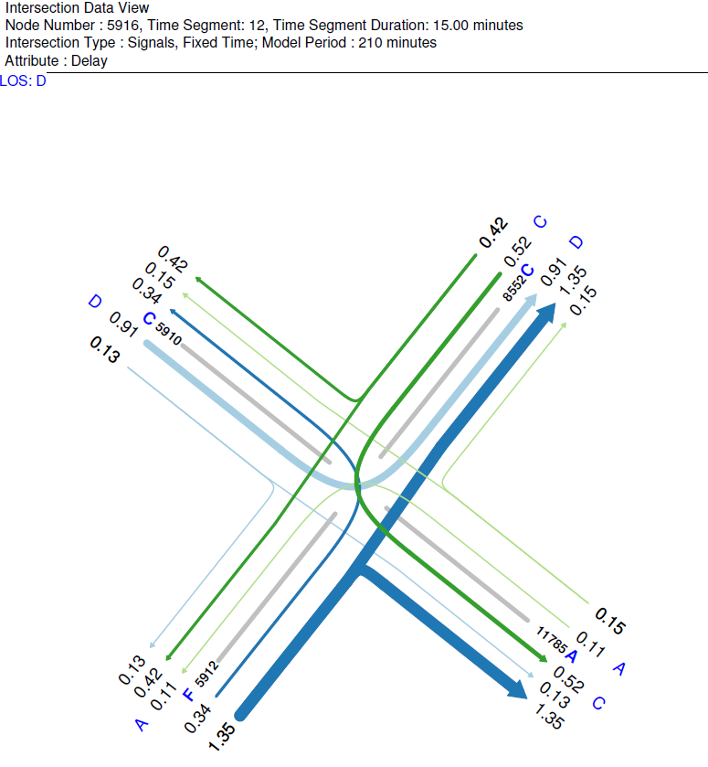
Intersection Model Outputs

Slide 36
Downstream Modeling Support
Provide basis for collaborative analysis at operational level with micro-simulation modeling.
Extract trip matrices by processing output packet log file using Stantec-developed processor.
Key Benefits:
  Temporal profile for inbound external and through trips will be more realistic, accounting for travel time lag reaching corridor from actual origin.
  Capacity constraints at external stations to eliminate unrealistic travel demand volumes entering the corridor.

Slide 37
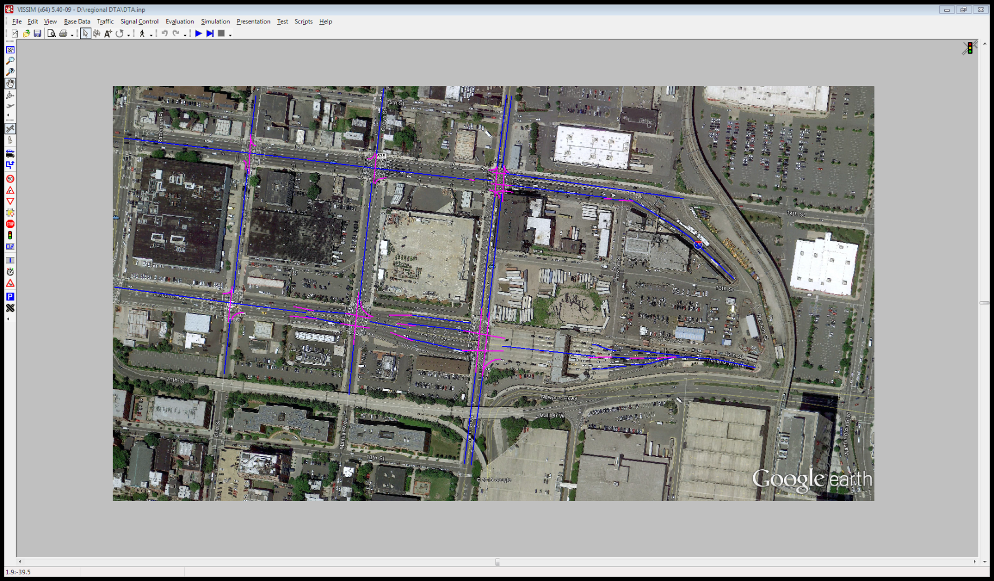
Downstream Modeling Support
Example: Micro-simulation Modeling in VISSIM for Holland Tunnel Entrance in New Jersey

Slide 38
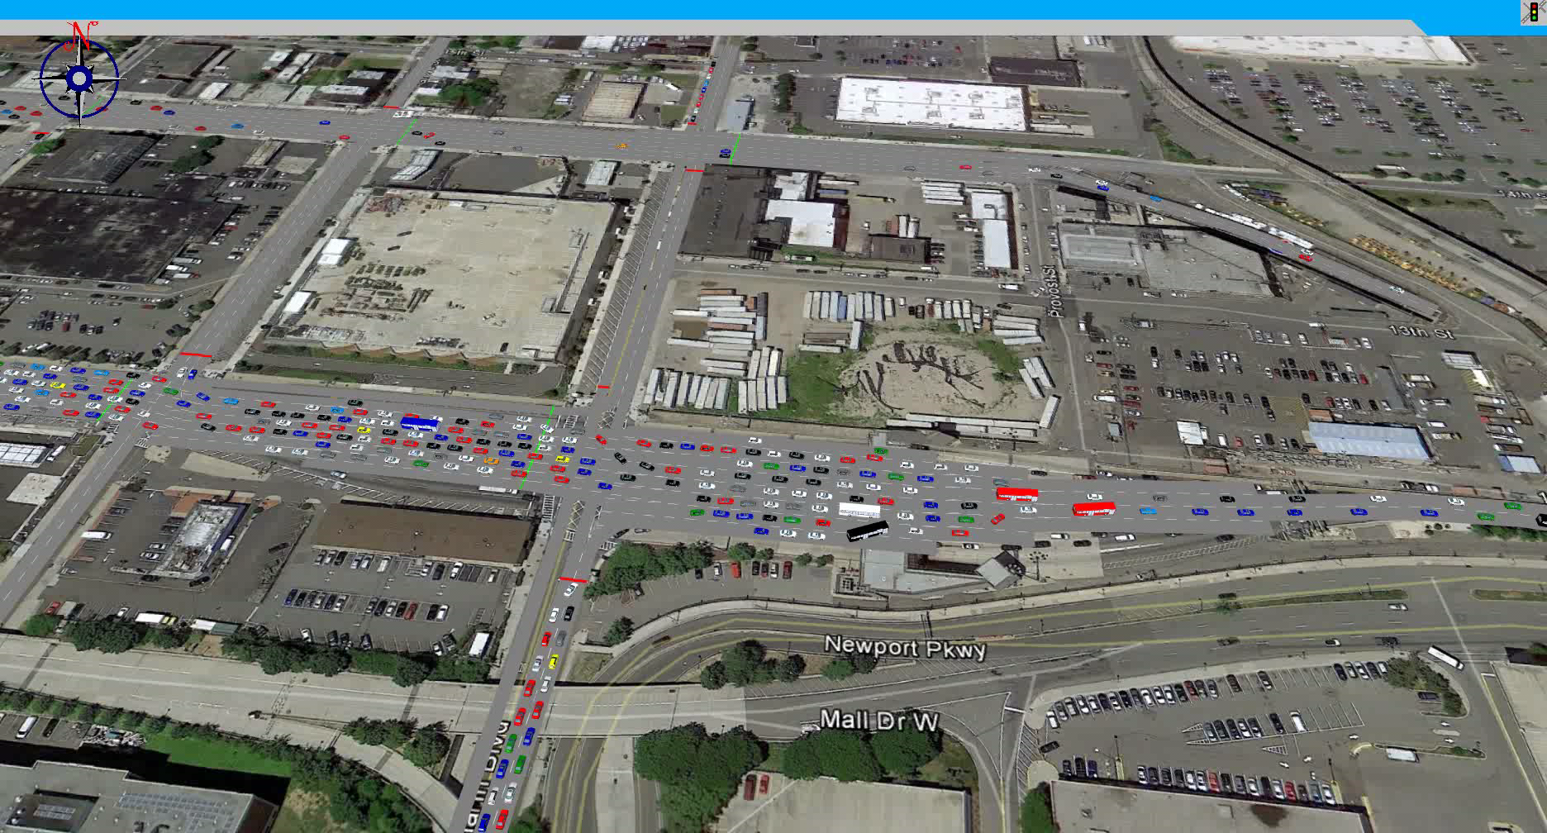
Downstream Modeling Support
Sample animation

Slide 39
Looking Ahead
5
How can we improve the model and where do we go from here?

Slide 40
Refinement Requirements
Reducing execution time with 64-Bit CUBE Avenue
Improvement to model performance can be achieved with additional calibration effort, leveraging available data.
Typical data include hourly traffic counts and travel speed estimates along strategic traffic corridors.
More comprehensive processing of TRANSCOM data.

Slide 41
Possible Application of Regional DTA Process
Cost-effectiveness of regional-level DTA platform as modeling tools (benefit/cost).
Options for incorporating into existing travel demand model platform:
Within feedback loop (significant increase in model run time);
Final iteration only.
Separate post-model application

Slide 42
Questions?

Slide 43
Placeholder

Slide 44
NJRTME Intersection Representation with Junction Modeling
1002
Major Arterial Approach:
2 lanes
1 Left Turn Lane
Detailed Signal Phasing with separate left turn
Capacity by movement
Capacity of 2350 Veh./Hr.
Major Arterial
Minor Arterial
1000
1005
1003
Minor Arterial Approach:
1 lane
1 Left Turn Lane
Detailed Signal Phasing with separate left turn
Capacity by Movement
Capacity of 650 Veh./Hr.
1004

Slide 45
Standard Intersection Representation
1002
Major Arterial Approach:
2 lanes
Capacity of 1800 Veh./Hr.
Major Arterial
Minor Arterial
1000
1005
1003
Minor Arterial Approach:
1 lane
Capacity of 500 Veh./Hr.
1004

Slide 46
NJRTME Intersection Representation
1002
Major Arterial Approach:
2 lanes
1 Left Turn Lane
Green/Cycle Ratio = .55
Capacity of 2250 Veh./Hr.
Major Arterial
Minor Arterial
1000
1005
1003
Minor Arterial Approach:
1 lane
1 Left Turn Lane
Green/Cycle Ratio = .35
Capacity of 750 Veh./Hr.
1004

