Slide 1



National Association of Regional Councils
MAP Forum Annual Meeting
December 3, 2021
Erich Zimmermann
Deputy Director/Transportation Director, NARC
@NARCRegions #RegionsLead
National Association of Regional Councils

Slide 2
Infrastructure Investment and Jobs Act
Infrastructure Investment and Jobs Act (IIJA)
Bipartisan Infrastructure Law (BIL)
$1.2T in total spending
  $550B in new spending
Includes Senate reauthorization, water infrastructure bills
Has funding for power, EVs, resiliency, airports, broadband
Senate negotiated package
Passed Senate with 69 votes; passed House 228-206 (13 Rs yes/6Ds no)
National Association of Regional Councils

Slide 3
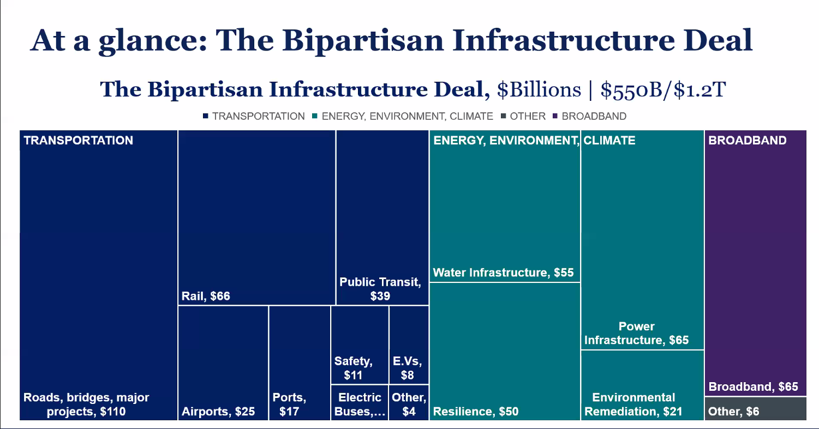
Infrastructure Investment and Jobs Act
National Association of Regional Councils

Slide 4
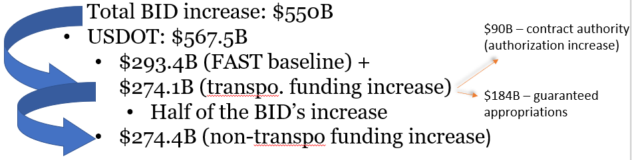
Infrastructure Investment and Jobs Act
What’s In the Bill for Transportation?
Full FAST Act reauthorization
Significant funding increases
New formula and discretionary programs, both within and outside of reauthorization
$567.5B for USDOT; $351B for FHWA, $91B for FTA
National Association of Regional Councils

Slide 5
Infrastructure Investment and Jobs Act
What’s In the Bill for Transportation?
 | 5-year Funding | % Increase
NHPP | $148.0B | 27%
STBGP* | $72.0B | 24%
HSIP | $15.6B | 34%
Carbon Reduction Program* | $6.42B | n.a.
PROTECT Program* | $7.3B | n.a.
CMAQ* | $13.2B | 10%
National Freight Program | $7.15B | 13%
STBGP Set-Aside (TAP)* | $7.2B | 71%
Metro. Planning (highway)* | $2.28B | 32%
Metro. Planning (transit)* | $0.8B | 42%
National Association of Regional Councils

Slide 6
Infrastructure Investment and Jobs Act
What’s In the Bill for Transportation?
Formula Funding vs. Discretionary Grants
  Two significant new formula programs within reauthorization
  Several additional new formula programs
    Bridges, EV charging, transit state of good repair
  Dozens of new discretionary programs
    Plus many new pilot programs
Bill sections that impact MPOs/RTPOs: 42
New formula programs (in reauthorization): 2
New competitive grant programs (transportation): 11
New competitive pilot programs: 6
National Association of Regional Councils

Slide 7
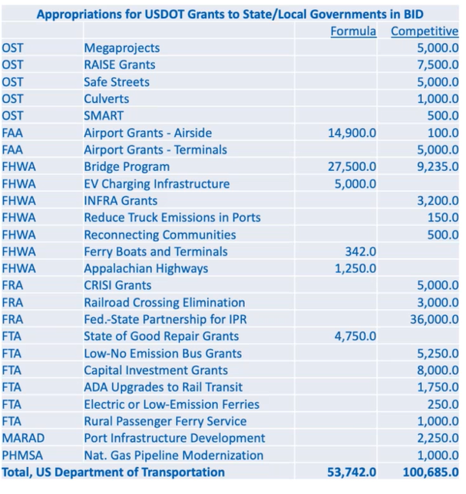
!
Source: Eno Transportation Weekly
National Association of Regional Councils

Slide 8
Infrastructure Investment and Jobs Act
Program policy changes
Surface Transportation Block Grant Program (STBGP)
Suballocation remains at 55%
Modifies the “population bands” within the program
Expands project eligibility
Transportation Alternatives Program (TAP)
Funding is substantially increased; TAP funding level is now 10% of STBGP
TAP suballocation is increased to 59% (currently 50%)
States may allocate 100% of its funding
MPOs serving an urbanized population of 200,000 or fewer are now eligible
Metropolitan Planning (PL)
MPO housing requirements added in final Senate compromise
Requires consistency in planning data when more than one MPO within an urbanized area
States and MPOs may use social media and other web-based tools to encourage public participation and solicit public feedback
When first designating officials, MPO must consider “the equitable and proportional representation of the population of the metropolitan planning area”
National Association of Regional Councils

Slide 9
Infrastructure Investment and Jobs Act
Congestion Mitigation and Air Quality (CMAQ) Program
New eligibilities (micromobility, heavy duty zero emission vehicles)
Funds can be used for operating assistance for public transportation projects, with no time limit in rural areas and in urbanized areas under 200K population
Increasing Safe and Accessible Transportation Options
States and MPOs must use at least 2.5% of their planning funds to carry out 1 or more activities “to increase safe and accessible options for multiple travel modes for people of all ages and abilities.”
Activities include:
  Development of Complete Streets standards
  Development of Complete Streets prioritization plan
  Development of active transportation plans
  Regional or megaregional planning to consider alternatives to new highway capacity
  Development of plans and policies to support transit-oriented development
National Association of Regional Councils

Slide 10
Infrastructure Investment and Jobs Act
New formula program
Carbon Reduction Program: new formula program to reduce transportation emissions.
65% of funds are suballocated to areas within the state by population (identical to STBGP)
Lots of eligible projects, including public transportation, bike/ped, ITS, congestion pricing
Each state, in consultation with any MPOs, has 2 years to develop a carbon reduction strategy; requires a state to consult with an RTPO when obligating funds for projects in a rural area.
Funding: $6.4B over five years.
National Association of Regional Councils

Slide 11
Infrastructure Investment and Jobs Act
New formula program
PROTECT Program: new program for resilience improvements; formula and competitive grants
Funding: $7.3B over five years by formula (2% for planning);
$1.4B for competitive grants
Eligible projects: storm surge, flood protection, or aquatic ecosystem restoration
MPOs eligible to receive resilience planning grants, resilience improvement grants, community resilience and evacuation route grants, at-risk coastal infrastructure grants
Federal share: 80%; Can be increased: + 7% if state/MPO has resilience improvement plan and prioritized the funded project; +3% if MPO has incorporated resilience plan into metropolitan transportation plan
National Association of Regional Councils

Slide 12
Infrastructure Investment and Jobs Act
National Infrastructure Project Assistance Grants (multi-modal, multi-jurisdictional projects of significance)
Strengthening Mobility and Revolutionizing Transportation (SMART) Program (demonstration projects for advanced smart city tech)
Rural Surface Transportation Grant Program (improve and expand the surface transportation infrastructure in rural areas.)
Bridge Investment Program (Discretionary) (encourage bridge repair that will improve safety, efficiency, and reliability of people and freight movement)
Grants for Charging and Fueling Infrastructure (publicly accessible electric vehicle charging and hydrogen, propane, and natural gas fueling infra)
Safe Streets and Roads for All Grant Program (Vision Zero)
Railroad Crossing Elimination Program (highway- or pathway-rail grade crossing improvements to improve safety and mobility of people and goods)
Healthy Streets Program (expand the use of cool pavement and porous pavement and expand tree cover)
Active Transportation Infrastructure Investment Program (to “provide safe and connected active transportation facilities in an active transportation network or active transportation spine.”)
National Association of Regional Councils

Slide 13
Infrastructure Investment and Jobs Act
Congestion Relief Program
New competitive congestion relief program to provide discretionary grants to “advance innovative, integrated, and multimodal solutions to congestion relief in the most congested metropolitan areas…”
Eligible projects include:
  Integrated congestion management system;
  HOV toll lanes, cordon price, parking pricing or congestion pricing;
  Mobility services such as commuter buses and vans; and
  Incentive programs to encourage carpooling.
Interstate tolling is allowed under specific circumstances.
MPOs over 1,000,000 population are eligible; states are eligible to obligate funds in urbanized areas under 1M population.
Funding: $250M over five years.
National Association of Regional Councils

Slide 14
Infrastructure Investment and Jobs Act
Safe Streets and Roads for All Grant Program:
New competitive grants to support "Vision Zero"
Funding: $1B over five years.
Requires a “Comprehensive Safety Action Plan” “aimed at preventing transportation-related fatalities and serious injuries in a locality; "Vision Zero" or "Toward Zero Deaths" plan.
  Elements of the plan:
    goals and timeline for eliminating fatalities and serious injuries;
    analyses of crash location and community input;
    data driven approach to identify projects or strategies; and
    mechanisms for evaluating outcomes and effectiveness.
MPOs are eligible entities.
Federal share is 80%.
Requires regular reporting to the Secretary and final report that outlines elements of the project carried out by the receiving entity.
National Association of Regional Councils

Slide 15
Infrastructure Investment and Jobs Act
Safe Streets and Roads for All Grant Program:
Eligible projects include development of the plan itself (40% of funding); planning, design, and development activities to execute on projects and strategies; or to carry out the projects or strategies themselves.
Project chosen based on whether it:
  Is likely to significantly reduce or eliminate transportation-related fatalities and serious injuries involving peds, cyclists, public transportation users, motorists, and commercial operators;
  Demonstrates engagement with public and private stakeholders;
  Adopts innovative technologies or strategies to promote safety;
  Employs low-cost, high-impact strategies that improve safety over a wider geographical area;
  Ensures equitable investment in the safety needs of underserved communities;
  Includes evidence-based projects or strategies; and
  Achieves other conditions as the Secretary determines.
National Association of Regional Councils

Slide 16
Infrastructure Investment and Jobs Act
Pilot programs
National Motor Vehicle Per-Mile User Fee Pilot: to study the potential for a national per-mile fee to replace gas tax: $50M
Prioritization Process Pilot Program: project scoring based on planning objectives: $50M
Reconnecting Communities Pilot Program: removing legacy highways that impact communities: Planning grants: $150M over five years; capital construction grants: $350M over five years; $500M in guaranteed appropriations
Transportation Access Pilot Program: to develop an accessibility data set and make it available to MPOs and RTPOs
Wildland Crossing Safety: to reduce wildlife-vehicle collisions and improve habitat connectivity; 60% of funds to rural areas: $350M
National Association of Regional Councils

Slide 17
Infrastructure Investment and Jobs Act
Whither (Wither?) the Highway Trust Fund
IIJA includes a $118B transfer to HTF
  $90B to Highway Account
  $28B to Transit Account
  Brings transfers to HTF since 2008 to more than
  TWO HUNDRED SEVENTY BILLION DOLLARS!!!
    That’s a lot of cheese!
IIJA does NOTHING for HTF solvency beyond the five years of the reauthorization (ie. no new revenue sources)
  The future cliff is that much worse
IIJA contains a mileage-based user fee study
National Association of Regional Councils

Slide 18
What’s Next?
Rulemaking, program writing, and eventually distributing funds and publishing NOFAs
Instructions to implement quickly
Think ahead and plan early
  Identify best fit(s) and form your team
  Do you need a grant writer?
  Ask for help!
  Notify your Members of Congress
NARC/AMPO are developing a process to provide feedback to the administration
@NARCRegions #RegionsLead
National Association of Regional Councils

Slide 19
National Association of Regional Councils
Thank you!
Erich Zimmermann
erich@narc.org
202-618-5697
Full analysis available at narc.org
@NARCRegions #RegionsLead
National Association of Regional Councils

