Slide 1

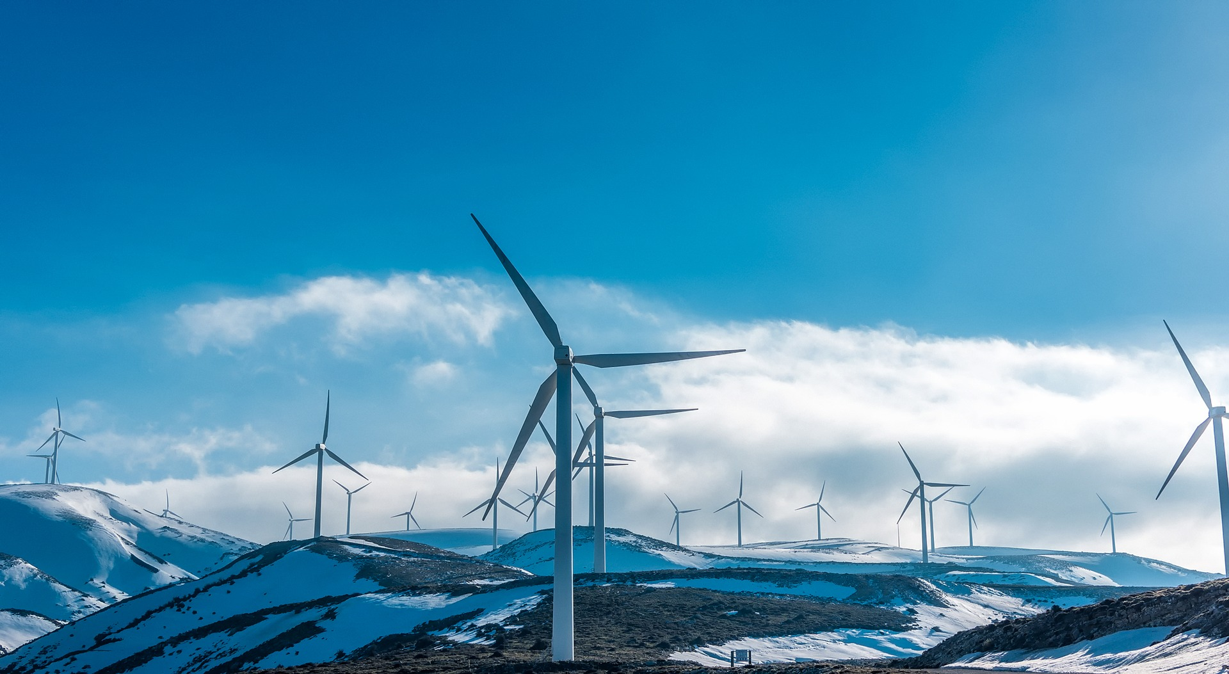
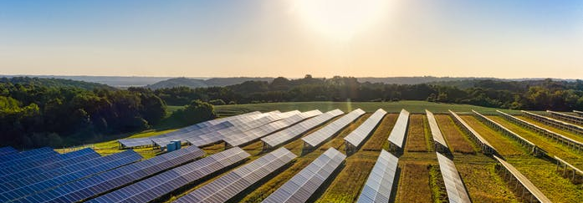

Transportation, Electrification and the Path to Net-zero
Jesse D. Jenkins
Assistant Professor | Princeton University
March 13th, 2023 – NJ Transportation Planning Authority

Slide 2

Net-Zero America
Historical and Modeled Net U.S. Greenhouse Gas Emissions (Including Land Carbon Sinks)
billion metric tons CO₂-equivalent (Gt CO₂-e)¹
Historical emissions²
Modeled emissions (REPEAT Project)
2021 emissions: ~5.6 billion tons
2005 emissions: ~6.6 billion tons
2030 NDC:
~3.3 billion tons
(at least 50% below 2005)
Net-Zero Pathway
Triple the average historical pace of decarbonization
1 - CO₂₋equivalent emissions calculations use IPCC AR4 100 year global warming potential as per EPA Inventory of Greenhouse Gas Emissions and Sinks.
2 - Historical data from US EPA Inventory for 2005-2030; 2021 preliminary emissions estimate assumes total net emissions change in proportion to 6.7% year-on-year change in CO2 emissions from energy and industrial processes estimated by Global Carbon Monitor.
Notes:
US goals: 50% below peak (2005) by 2030, net-zero by 2050. Consistent arguably with a 1.5-2C world
Triple the average pace of decarbonization to 6%.

Slide 3
Sizing up the challenge
REFERENCE
Liquid and gaseous hydrocarbons and petrochemical feedstocks.
Carbon-free carriers like electricity, steam, hydrogen, plus
biomass-
derived fuels.
Options:
Carbon capture and storage
Carbon-neutral substitutes like some biofuels, hydrogen, or electro-fuels
Negative emissions technologies like carbon dioxide removal
Data source: Net-Zero America study, Reference scenario 2050 final energy consumption
Notes:
So how do we get it done?
If we take a look at U.S. demand for final energy carriers, like fuels and electricity, we can start to size up the challenge.
About one-third of U.S. demand is met by zero-carbon energy carriers like electricity, steam, and hydrogen. Those carriers don’t contain or emit any CO2 themselves when consumed. So swap out clean electricity sources for fossil fuels to produce these energy carriers and we’re good. Easy enough.
The problem is that the other two-thirds of demand is for liquid and gaseous hydrocarbons: fossil fuels like gasoline, diesel, jet fuel, and natural gas, as well as the petrochemical feedstocks that make everything from plastics to pharmaceuticals to fertilizers. Those ones are trickier.
Our options here are to capture the CO2 emitted when using these fuels, produce carbon neutral substitutes, like some biofuels, or try to offset the resulting emissions by removing and storing CO2 from the atmosphere.
While each of those options works, they are a lot more costly than producing carbon-free electricity and each has their limits. It’s just too big a lift to tackle the full scale of our hydrocarbon demand with these solutions. We simply have to knock down the size of our demand for hydrocarbon fuels. And that’s where clean electricity does double duty…

Slide 4
Clean electricity: the linchpin
Total annual U.S. electricity generation by resource
Billion kilowatt-hours (or terawatt-hours)
>2x all current generation
Equal to all current generation
1.5x current carbon-free electricity by 2030
Data source: REPEAT Project,
Net-Zero Pathway

Slide 5
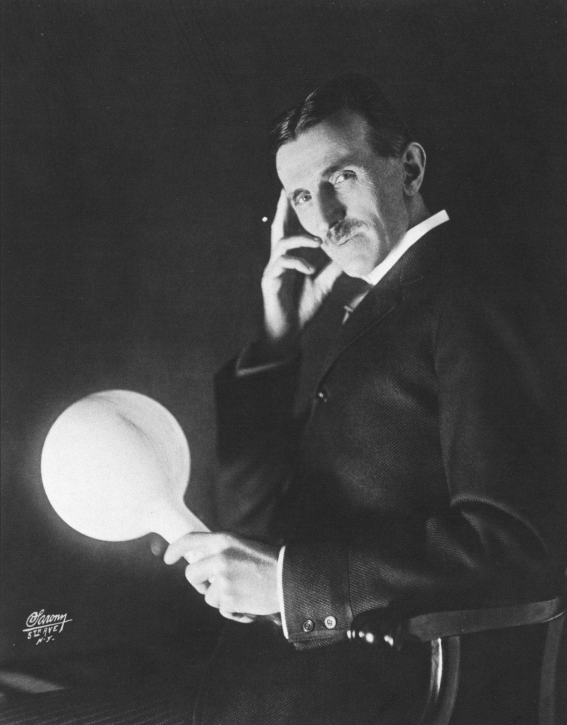
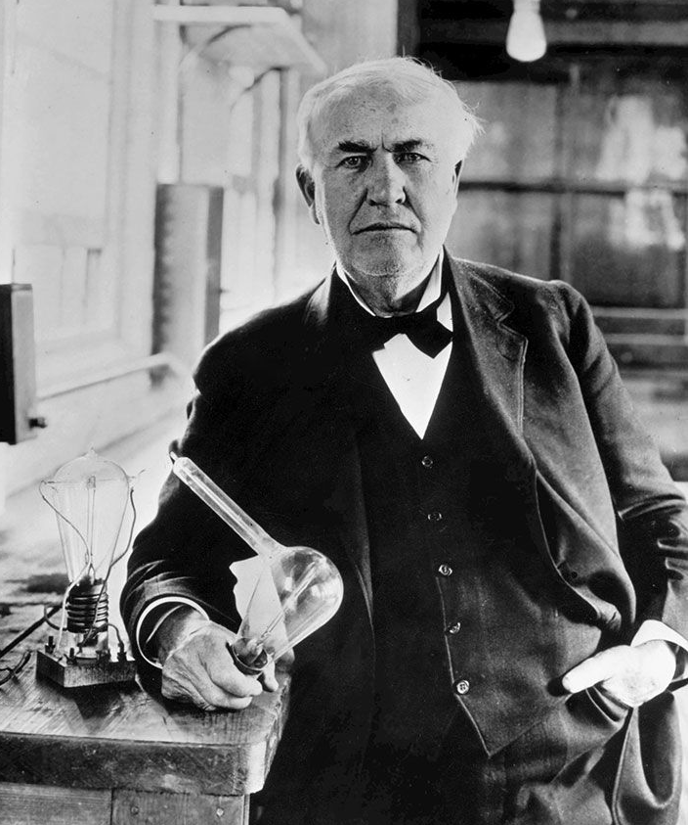
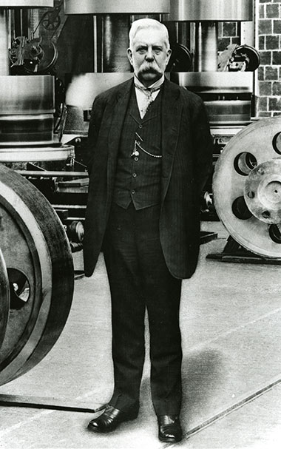
140 years since the days of Edison, Tesla, and Westinghouse…
Notes:
In other words, it took us about 140 years from the days of Edison, Tesla and Westinghouse to build today’s modern grid. Now we have to build that much new clean electricity and associated power lines again, twice, over the next 30 years!

Slide 6
Smashing new records
Historical power generation capacity additions vs modeled Net-Zero Pathway
gigwatts per year
Historical
Modeled
2x peak wind & solar pace through 2030;
3.5x from 2031-2035
2031-2032
2022-2024
2033-2035
2029-2030
2027-2028
2025-2026
Data source: REPEAT Project,
Net-Zero Pathway
Notes:
We’ll need to deploy wind and solar capacity at a rate of nearly 70 gigawatts per year through 2030, and accelerate to 124 per year from 2031-2035.
Wind additions peaked at about 15 gigawatts in 2020 and solar reached nearly 20 gigawatts last year. So through the end of 2030, we’ll need to double our fastest pace of adding renewables—and then accelerate to 3.5 times that rate by 2035.
Fortunately, the U.S. Energy Information Administration, the federal government’s energy statistics agency, thinks we’ll see an average of 44 gigawatts of solar added each year in 2023 and 2024, more than double the nearly 20 gigawatt record built last year. So we’re on pace for solar.
The bad news is that—due to supply chain issues, long wait times to connect to the grid, and the anemic pace of long-distance transmission build-out— the wind sector is falling behind; in 2023 and 2024 , EIA expects we’ll add just 6-7 GW per year, or half as much wind capacity as we did at our peak rate . We’ve got to accelerate, or we’ll fall far short of the nation’s clean energy goals.

Slide 7
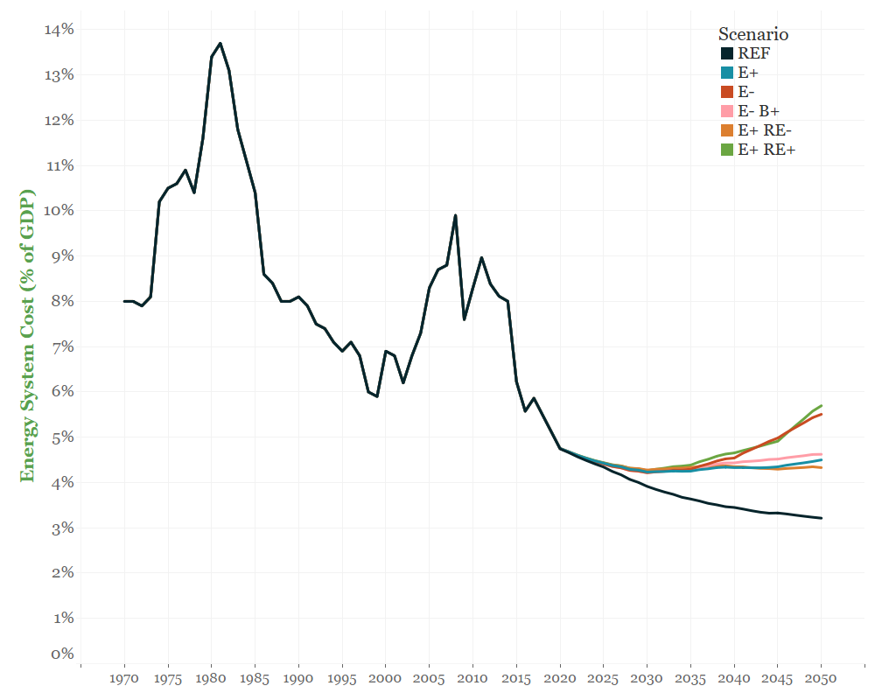
Transformative, but affordable
Oil price shocks
E+ RE+
E-
E- B+
E+
Global financial crisis
E+ RE-
REF
Energy System Cost
(% of GDP)
Energy System Cost (% of GDP)
E+ RE+
E-
E- B+
E+
E+ RE-
REF
Source: Net-Zero America study
Notes:
The good news: this is remarkably affordable. The Net-Zero America study estimates we can make the transition to net-zero emissions while spending less as a share of our economy’s gross domestic product on energy services than we have during recent prosperous periods of American history, and far less than during energy crises, past and present.

Slide 8
THE GOOD NEWS: WIND, SOLAR, BATTERY COSTS PLUMMET…
Wind, solar, and battery costs have plummeted…
Total cost declines (2010-2021)
Li-ion packs $/KWh -89%
Utility Solar PV $/MWh -85%
Onshore Wind $/MWh -69%
Levelized cost of wind and solar ($/MWh)
Lithium-ion battery pack costs ($/KWh)
Data Sources: Wind & solar costs from Lazard (2021), Lazard’s Levelized Cost of Energy Analysis – Version 15.0.
Battery pack costs from Bloomberg New Energy Finance (2021), Battery Price Survey.
Notes:
The main reason is that costs have plummeted over the last decade for wind and solar power as well as Lithium-ion batteries – the principle cost component of electric vehicles and our best option today for grid-connected energy storage.
Since 2010, costs for solar power and battery packs have fallen about 90% and costs for wind power by more than two-thirds.

Slide 9
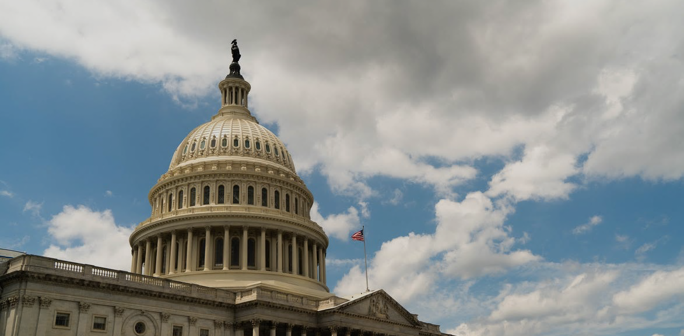
And now, with the passage of the Inflation Reduction Act, for the first time in history, the full financial might of the federal government is aligned behind the
clean energy transition...

Slide 10

The Infrastructure Law and Inflation Reduction Act focus on making clean energy* cheap
* (and other climate solutions)
Well over $500 billion in tax credits, grants, rebates, and loan guarantees for:
clean electricity
hydrogen and clean fuels
carbon capture & storage
electric vehicles
energy efficiency & electrification
technology demonstration, hubs, and network infrastructure
Notes:
The Inflation Reduction Act covers part of the tab for everything you want to put in the portfolio of a clean energy system, cutting the cost of clean energy and other climate solutions by on the order of 10-50% depending on the technology/solution.

Slide 11


Historical and Modeled Net U.S. Greenhouse Gas Emissions (Including Land Carbon Sinks)
billion metric tons CO₂-equivalent (Gt CO₂-e)¹
Historical emissions²
Modeled emissions
Bipartisan Infrastructure Law:
~4.8 billion tons in 2030
(~27% below 2005)³
2021 emissions²: ~5.6 billion tons
Frozen Policies (January 2021)
~4.9 billion tons in 2030
(~26% below 2005 in 2030)
2005 emissions²: ~6.6 billion tons
2030 target: 50% below 2005
Without the Inflation Reduction Act, the U.S. faced a 1.5 billion ton annual emissions gap in 2030
Net-Zero Pathway
~3.3 billion tons in 2030
(50% below 2005)
1 - CO₂₋equivalent emissions calculations use IPCC AR4 100 year global warming potential as per EPA Inventory of Greenhouse Gas Emissions and Sinks. All values should be regarded as approximate given uncertainty in future outcomes.
2 - Historical data from US EPA Inventory for 2005-2030; 2021 preliminary emissions estimate assumes total net emissions change in proportion to 6.7% year-on-year change in CO2 emissions from energy and industrial processes estimated by Global Carbon Monitor.
3 - Modeled emissions exclude any changes in passenger and freight miles traveled due to surface transportation, rail, and transit investments in IIJA. According to the Georgetown Climate Center, emissions impact of these changes depend heavily on state implementation of funding from IIJA, which could result in anywhere from -14 Mt to +25 Mt change in CO₂ emissions from transportation in 2030.
4 - Results reflect preliminary modeling based on the July 27, 2022 draft legislation.
5 - Results reflect average of estimated high and low oil & gas production scenarios, which span +/- 20 Mt CO₂-e in 2030 (see p. 13-14). Impact on land carbon sinks based on analysis by Energy Innovation.
Notes:
The Senate Inflation Reduction Act could:
cut annual emissions in 2030 by an additional ~1 billion metric tons below current policy (including the Bipartisan Infrastructure Law)
close two-thirds of the remaining emissions gap between current policy and the nation’s 2030 climate target (50% below 2005)
get the U.S. to within ~0.5 billion tons of the 2030 climate target
reduce cumulative GHG emissions by about 6.3 billion tons over the next decade (through 2032), ~80% of the cumulative reductions under the
House-passed Build Back Better Act

Slide 12
Historical and Modeled Net U.S. Greenhouse Gas Emissions (Including Land Carbon Sinks)
billion metric tons CO₂-equivalent (Gt CO₂-e)¹
Historical emissions²
Modeled emissions
2021 emissions²: ~5.6 billion tons
2005 emissions²: ~6.6 billion tons
Inflation Reduction Act:
~3.8 billion tons in 2030
(~42% below 2005)^{4,5}
2030 target: 50% below 2005
The Inflation Reduction Act could cut annual emissions in 2030 by an additional ~1 billion metric tons
1 - CO₂₋equivalent emissions calculations use IPCC AR4 100 year global warming potential as per EPA Inventory of Greenhouse Gas Emissions and Sinks. All values should be regarded as approximate given uncertainty in future outcomes.
2 - Historical data from US EPA Inventory for 2005-2030; 2021 preliminary emissions estimate assumes total net emissions change in proportion to 6.7% year-on-year change in CO2 emissions from energy and industrial processes estimated by Global Carbon Monitor.
3 - Modeled emissions exclude any changes in passenger and freight miles traveled due to surface transportation, rail, and transit investments in IIJA. According to the Georgetown Climate Center, emissions impact of these changes depend heavily on state implementation of funding from IIJA, which could result in anywhere from -14 Mt to +25 Mt change in CO₂ emissions from transportation in 2030.
4 - Results reflect preliminary modeling based on the July 27, 2022 draft legislation.
5 - Results reflect average of estimated high and low oil & gas production scenarios, which span +/- 20 Mt CO₂-e in 2030 (see p. 13-14). Impact on land carbon sinks based on analysis by Energy Innovation.
Notes:
The Senate Inflation Reduction Act could:
cut annual emissions in 2030 by an additional ~1 billion metric tons below current policy (including the Bipartisan Infrastructure Law)
close two-thirds of the remaining emissions gap between current policy and the nation’s 2030 climate target (50% below 2005)
get the U.S. to within ~0.5 billion tons of the 2030 climate target
reduce cumulative GHG emissions by about 6.3 billion tons over the next decade (through 2032), ~80% of the cumulative reductions under the
House-passed Build Back Better Act

Slide 13
Historical and Modeled Net U.S. Greenhouse Gas Emissions (Including Land Carbon Sinks)
billion metric tons CO₂-equivalent (Gt CO₂-e)¹
Historical emissions²
Modeled emissions
2021 emissions²: ~5.6 billion tons
2005 emissions²: ~6.6 billion tons
Inflation Reduction Act:
~3.8 billion tons in 2030
(~42% below 2005)^{4,5}
2030 target: 50% below 2005
And by driving down the cost of clean energy and other climate solutions, the Act makes it easier for states or cities or companies to increase their climate ambitions. It also lowers the cost of compliance with any future regulations.
1 - CO₂₋equivalent emissions calculations use IPCC AR4 100 year global warming potential as per EPA Inventory of Greenhouse Gas Emissions and Sinks. All values should be regarded as approximate given uncertainty in future outcomes.
2 - Historical data from US EPA Inventory for 2005-2030; 2021 preliminary emissions estimate assumes total net emissions change in proportion to 6.7% year-on-year change in CO2 emissions from energy and industrial processes estimated by Global Carbon Monitor.
3 - Modeled emissions exclude any changes in passenger and freight miles traveled due to surface transportation, rail, and transit investments in IIJA. According to the Georgetown Climate Center, emissions impact of these changes depend heavily on state implementation of funding from IIJA, which could result in anywhere from -14 Mt to +25 Mt change in CO₂ emissions from transportation in 2030.
4 - Results reflect preliminary modeling based on the July 27, 2022 draft legislation.
5 - Results reflect average of estimated high and low oil & gas production scenarios, which span +/- 20 Mt CO₂-e in 2030 (see p. 13-14). Impact on land carbon sinks based on analysis by Energy Innovation.
Notes:
The Senate Inflation Reduction Act could:
cut annual emissions in 2030 by an additional ~1 billion metric tons below current policy (including the Bipartisan Infrastructure Law)
close two-thirds of the remaining emissions gap between current policy and the nation’s 2030 climate target (50% below 2005)
get the U.S. to within ~0.5 billion tons of the 2030 climate target
reduce cumulative GHG emissions by about 6.3 billion tons over the next decade (through 2032), ~80% of the cumulative reductions under the
House-passed Build Back Better Act

Slide 14

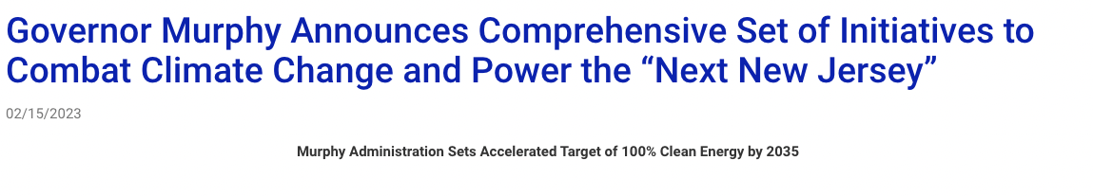
The Governor outlined six pillars that will serve as the foundation for a cleaner, greener, and more resilient New Jersey.
Adoption through Executive Order No. 315 of an accelerated target of 100% clean energy by 2035…
Adoption through Executive Order No. 316 of a target to install zero-carbon-emission space heating and cooling systems in 400,000 homes and 20,000 commercial properties …
Initiation through Executive Order No. 317 of a process … to plan for the Future of the Natural Gas Utility in New Jersey
Allocation of $70 million … toward lowering consumer upfront costs for medium- and heavy-duty EV adoption
Initiation of the stakeholdering process to adopt Advanced Clean Cars II in New Jersey, which would require all new cars and light-duty truck sales to be zero-emission vehicles (ZEV) by 2035
… provide enhanced flood protection for homeowners, businesses, and infrastructure against increased flooding in riverine and coastal areas

Slide 15
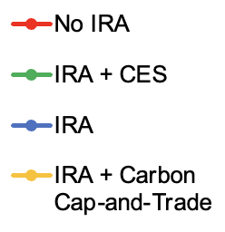
Thanks to the Inflation Reduction Act, the PJM region can now cut PJM CO₂ emissions 80-90%
by 2035 while keeping electricity supply costs comparable to or lower than recent years
PJM CO₂ emissions (medium fuel cost, medium RE cost case)
Million metric tons per year
PJM load-serving entity bulk supply cost (medium fuel cost, medium RE cost case)
2020 USD per MWh
2021 PJM LSE cost: $61.3/MWh
2019/2021 PJM Emissions: ~320 million tons
IRA + Cap & Trade
-36%
2019 PJM LSE cost: $50.2/MWh
Without further policy, PJM emissions will rebound from 2030 to 2035 because of growing demand and resumption of nuclear retirements after expiration of IRA PTC for existing nuclear.
-79 to
-90%

Slide 16
Going electric
Historical New Jersey EV and PHEV light vehicle sales sales and Advanced Clean Cars II targets
% of light duty vehicles per year
Notes:
~60% growth year on year from 2021-2022, more than enough to be on track for Advanced Clean Cars II goals.

Slide 17
We have time to prepare
Modeled US EV and PHEV sales and stock shares
Light duty vehicles Medium & heavy duty vehicles
Notes:
Stock lags behind sales, giving us more time to prepare the grid

Slide 18
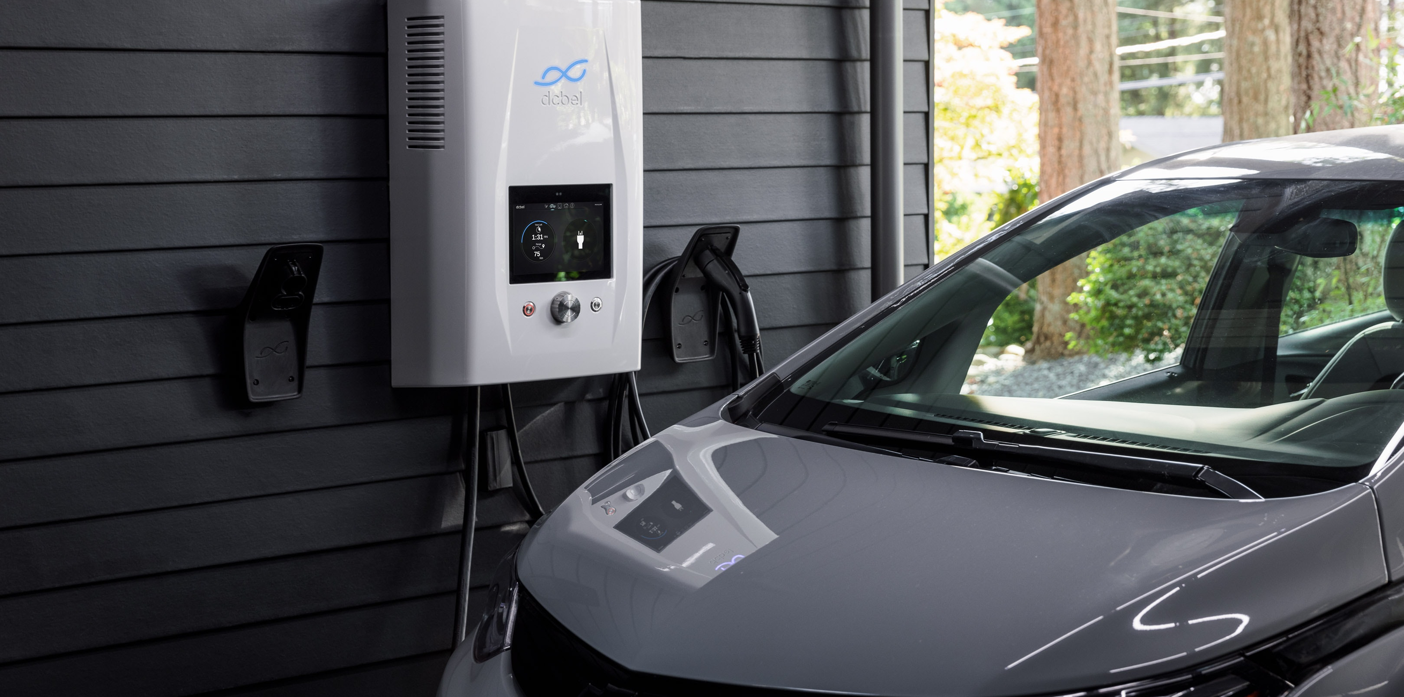
Unlocking charging flexibility
US electric cars sold in 2022 averaged 291 miles range
That’s 7 days of the average American’s daily commute
An EV battery offers enormous flexibility to shift charging patterns to avoid stressing the grid...
…if properly incentivized.
Unlocking flexible EV charging and water heating could reduce NJ peak demand by 16% in 2040.

Slide 19
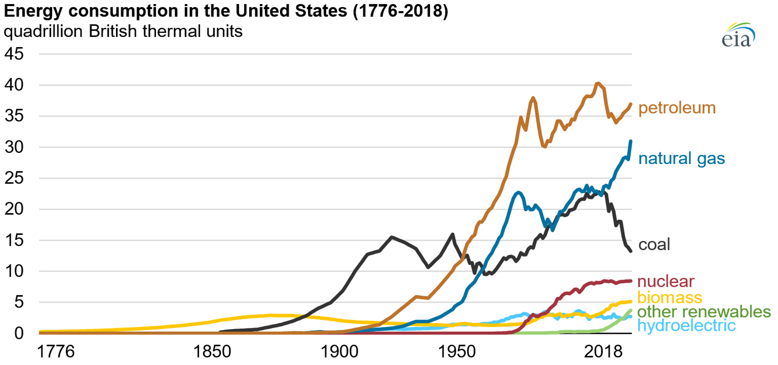
For all of U.S. history, petroleum and natural gas consumption has steadily risen (outside of recessions)…

Slide 20
Changes in Annual U.S. Petroleum Product and Natural Gas Consumption vs No IRA Case (Including Bipartisan Infrastructure Law)
Inflation Reduction Act
Petroleum Products
million barrels per year (mmbbl/y)
Natural Gas
billion cubic feet per year (bcf/y)
The Inflation Reduction Act drives U.S. consumption of petroleum products (gasoline, diesel fuel, etc) down 13% vs 2021 (and ~25% in 2035)
The Inflation Reduction Act reduces U.S. natural gas consumption in 2030 by 17%
vs 2021 consumption.

Slide 21
Annual Avoided Premature Deaths From Exposure to Fine Particulate Matter From Energy Activities vs No IRA Case (Including Bipartisan Infrastructure Law)
Thousands
Cumulative Avoided Premature Deaths vs No IRA Case (Including Bipartisan Infrastructure Law)
Thousands
Inflation Reduction Act
The Inflation Reduction Act could avoid over 35,000 premature deaths ($315 billion in avoided damages) over the decade from 2023-2032
¹
By 2030, the Inflation Reduction Act could save 5,900 lives annually, rising to 9,600 by 2035.
1 – Mortalities from exposure to PM 2.5 pollution from oil and gas production is estimated based on the average of production under the High and Low Oil & Gas Production scenarios (see p. 13).

Slide 22

The new challenge: how fast can we scale??

Slide 23

repeatproject.org

